Slide 1


Cordova Android Application Configuration

Slide 2
What is Cordova
Cordova is a Hybrid Mobile Application Framework used to build Android/iOS apps using
HTML
CSS
JavaScript
Cordova wraps the Web Application into a Native WebView and give access to device hardware(e.g. Camera) via Native Plugins

Slide 3
How Cordova Works
Cordova = Web App + Native Bridge + WebView Container
Web App: HTML+JS+CSS
Bridge: cordova.js : Bridge between JavaScript and native code
WebView Container : Cordova WebView : Displays Web UI in Native Android App

Slide 4
Flow of Execution
Step1 : MainActivity(extends CordovaActivity) starts
Step 2: Initializes Cordova WebView
Steps3: WebView loads :
Android_assest/www/index.html
Step4: Execute cordova.js
Step5: Other app logics

Slide 5
Importance od Cordova Activity
MainActivity extends CordovaActivity, which provides:
  Automatic WebView setup
  Plugin management
  Config.xml processing
  Native–JS bridge creation
CordovaActivity is the heart of the Cordova Android runtime.

Slide 6
Important Cordova Commands
cordova create DemoApp com.example.demo DemoApp
2. cordova platform add android
3. cordova platform ls
4. cordova build android
5. cordova plugin add cordova-plugin-device

Slide 7
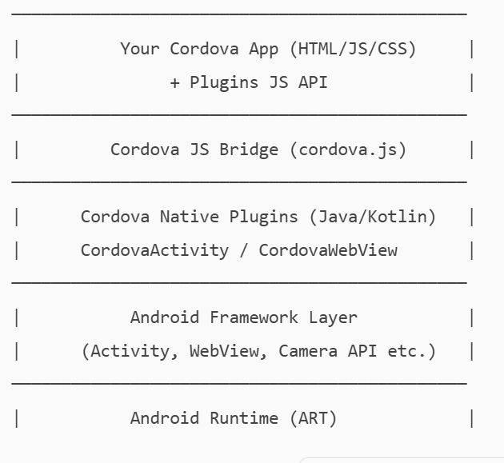
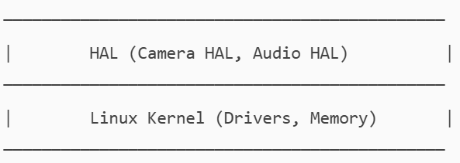
High Level Android + Cordova Architecture
Application Layer

Slide 8
Thank You

